Slide 1
Personal Assistant Chatbot

Slide 2
Introduction
Objective: Build a personal assistant chatbot system that simplifies user interactions and automates task management.
Purpose: Provide a smart solution for task scheduling and management with a user-friendly interface.
Target Audience: Individuals seeking efficient task handling and communication tools.

Slide 3
Problem Statement
Challenges Faced by Users:
Difficulty in managing multiple tasks efficiently.
Lack of an integrated, personalized assistant.
Existing Solutions:
General-purpose chatbots or voice assistants.
Limitations: Limited customization and higher complexity.

Slide 4
Proposed Solution
Features:
AI-driven chatbot for accurate responses.
Task management with CRUD operations and regular notifications.
Secure user authentication and data storage using MongoDB.
Benefits:
Simple and interactive user experience.
Reliable backend for fast and scalable operations.

Slide 5
System Architecture
Backend: Django and FastAPI for handling API requests.
AI Logic: Gemini prompts for context-aware responses.
Storage: MongoDB for task data and user authentication.
Frontend: Flutter-based UI created in Android Studio.

Slide 6
Development Progress
Completed Tasks:
Backend functionality using Django and FastAPI.
MongoDB integration for task storage and user authentication.
Basic chat UI implemented.
Full CRUD operations for tasks (create, retrieve, update, delete).
Pending Tasks:
Notifications and reminders based on user settings.
UI enhancements for better interaction.

Slide 7
Gemini Prompts Overview

Slide 8
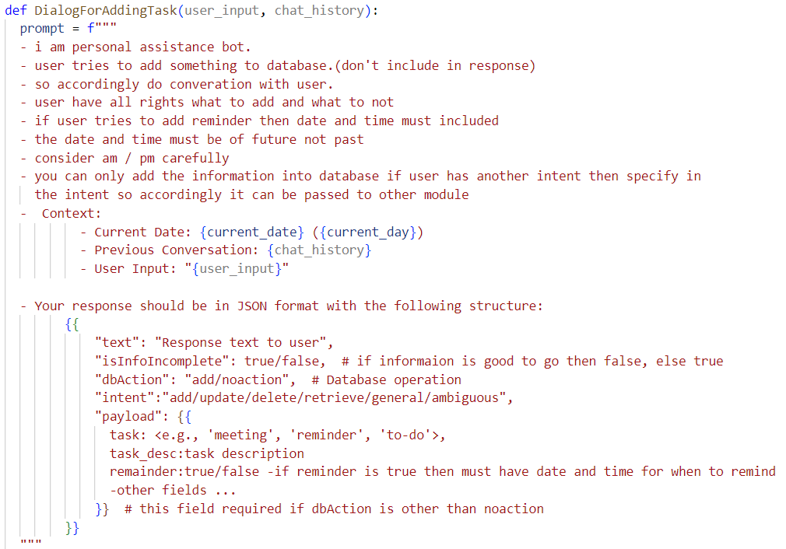

Slide 9
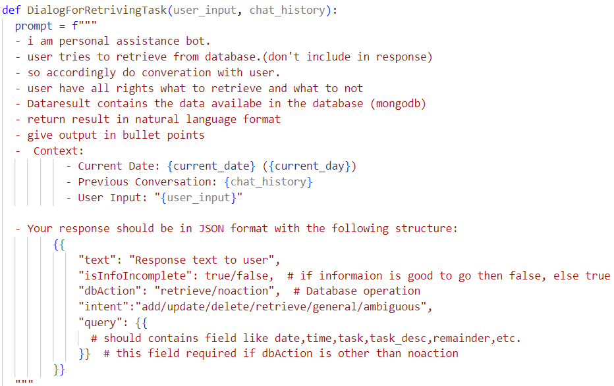

Slide 10
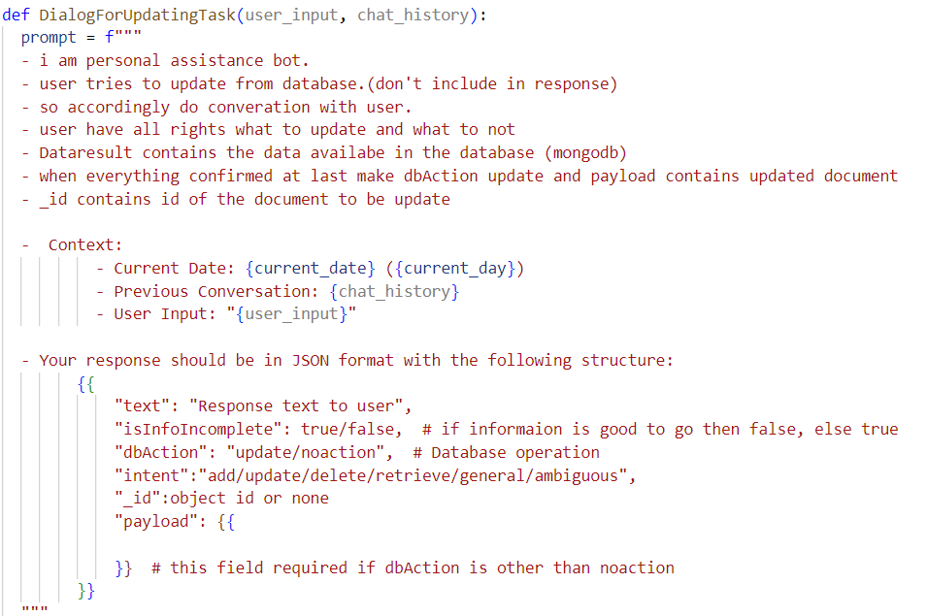

Slide 11
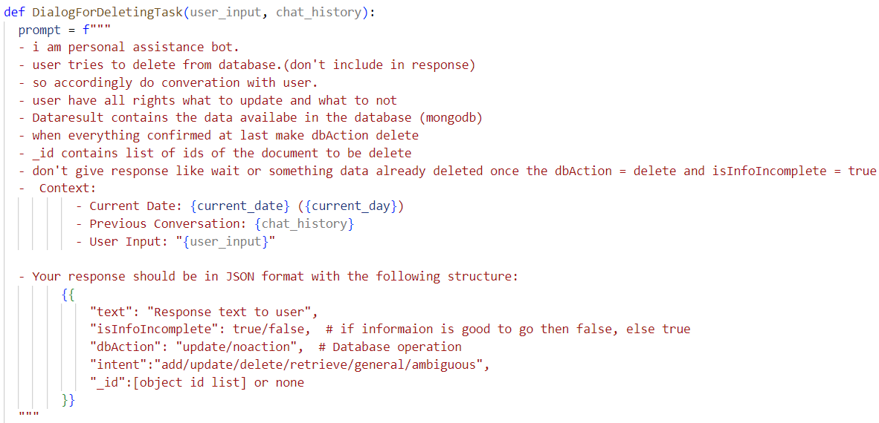

Slide 12
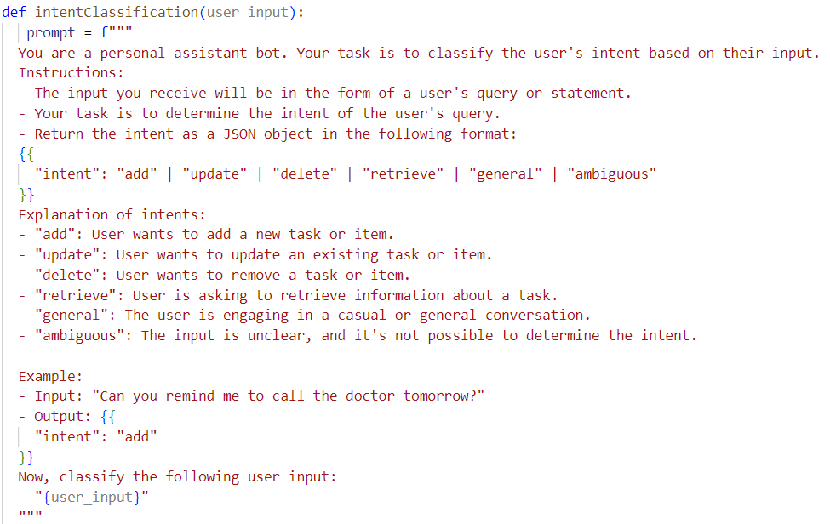

Slide 13
Screenshots

Slide 14
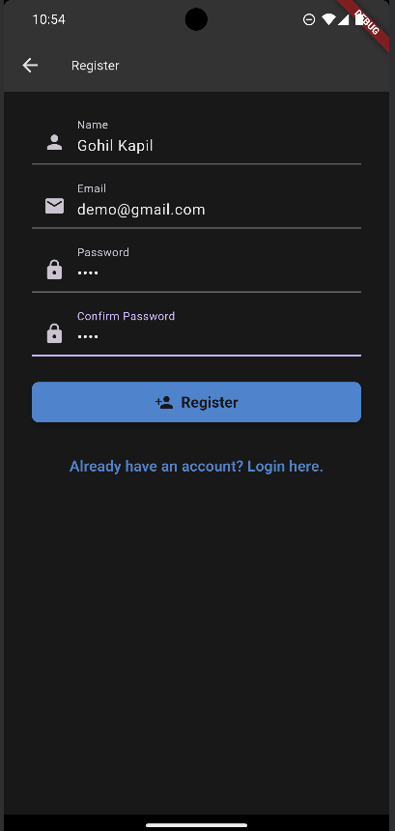
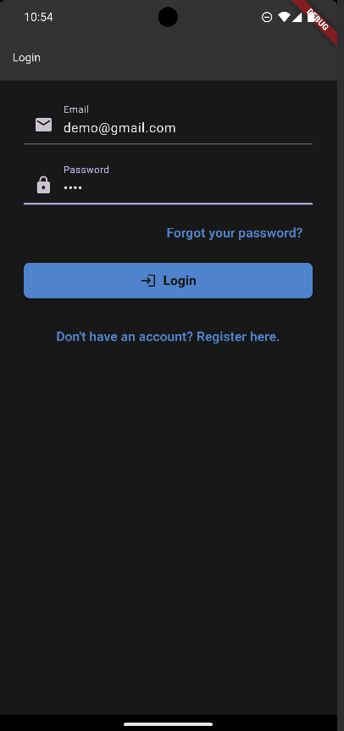
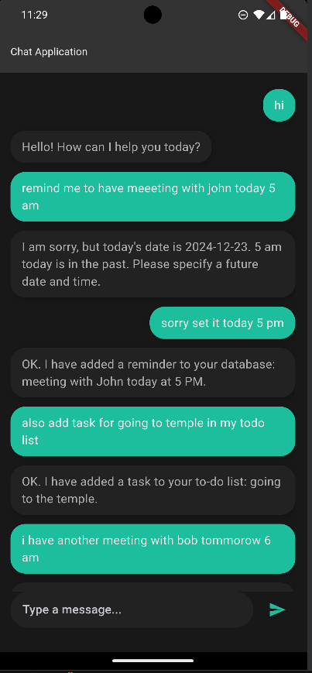

Slide 15
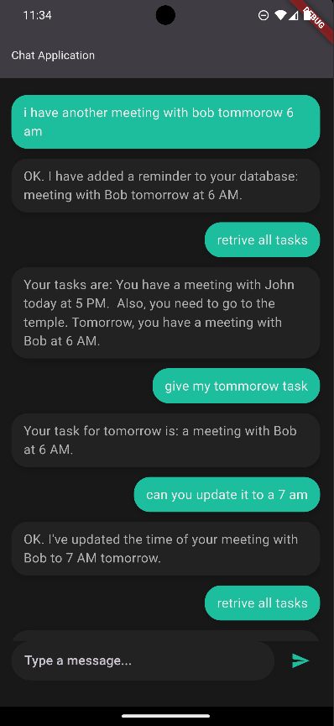
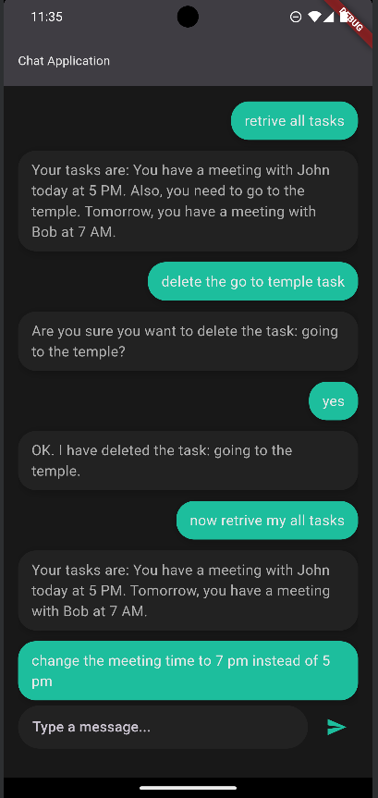
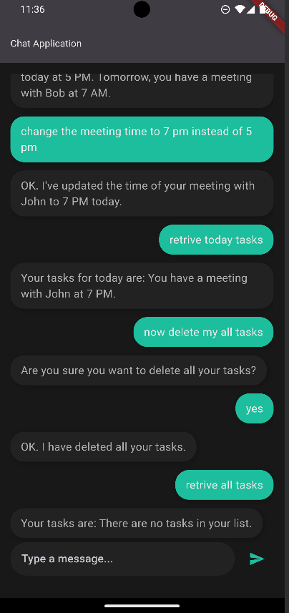

Slide 16
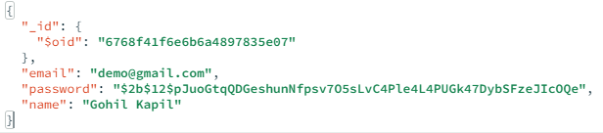
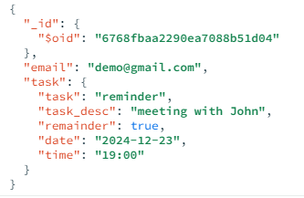
Document Format

Slide 17
New Features
1. Google Authentication
Secure login for users via Google accounts.
2. Google Calendar Integration
Seamless task scheduling and reminders using Google Calendar.

Slide 18
Progress Comparison
Previous Progress:
Backend functionality and CRUD operations completed.
Basic chat UI implemented.
Recent Developments:
Added secure Google Authentication.
Integrated Google Calendar for task scheduling.
Implemented conflict-checking functionality.
Improved the prompts and reduced number of prompts.

Slide 19
Gemini Updated Prompts

Slide 20
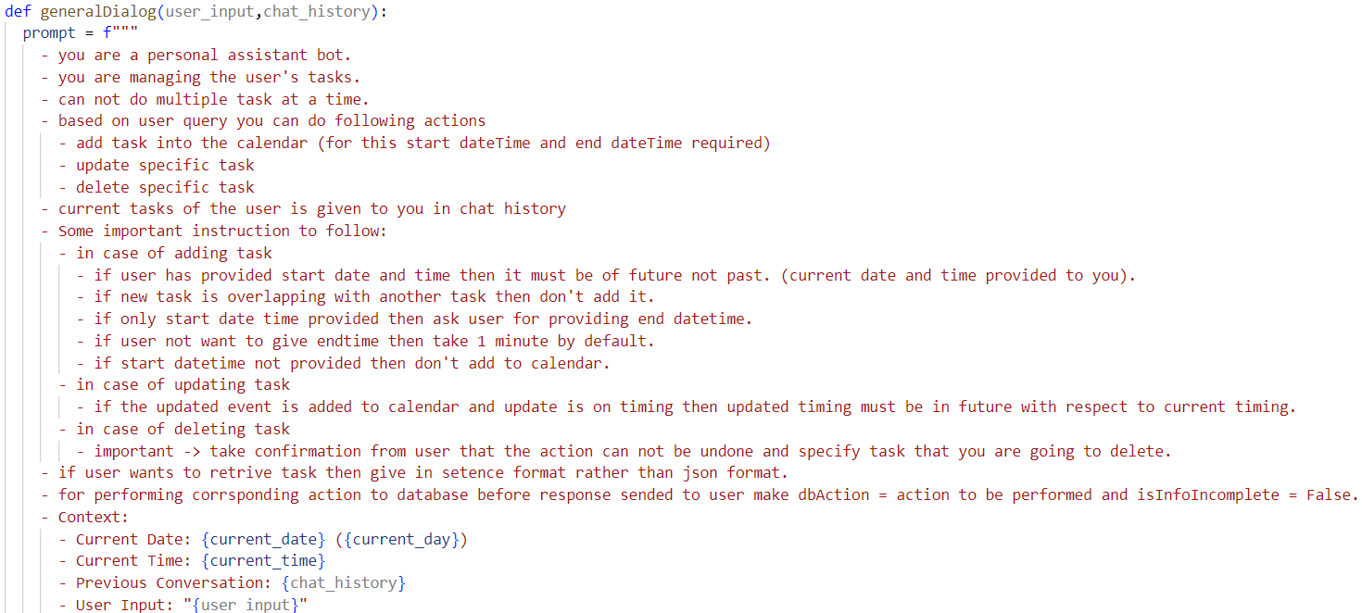

Slide 21
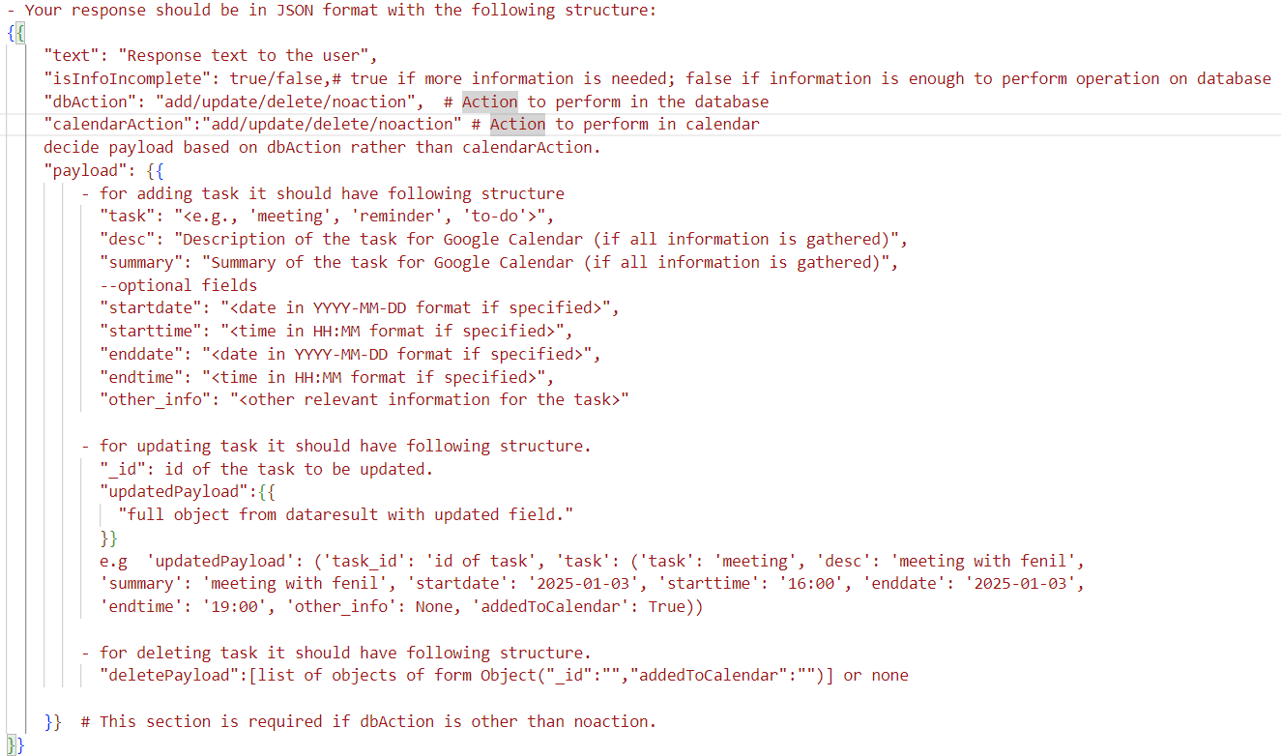

Slide 22
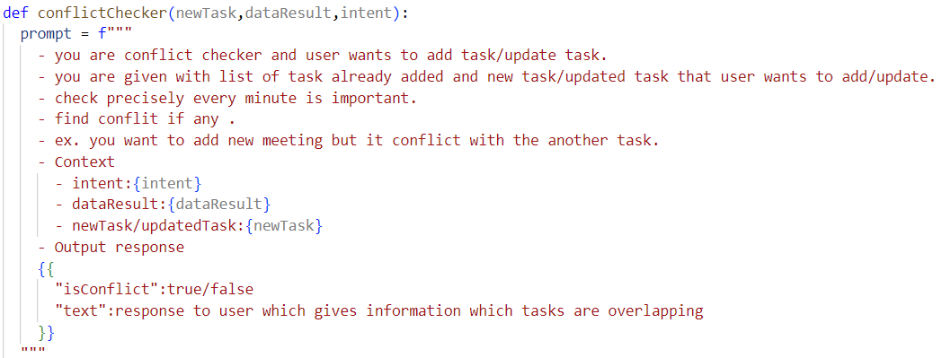

Slide 23
Project Demo

Slide 24
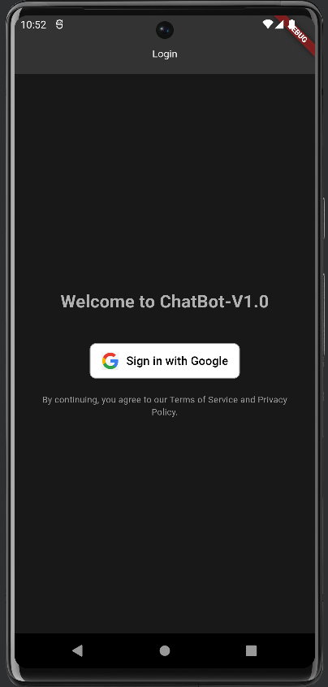
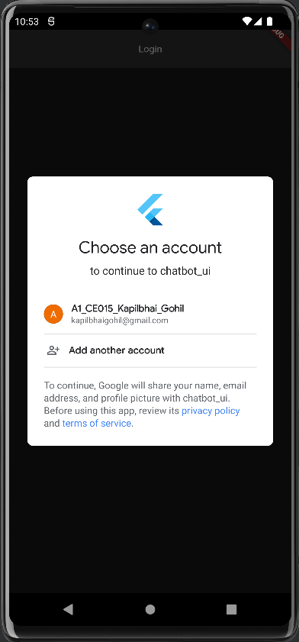
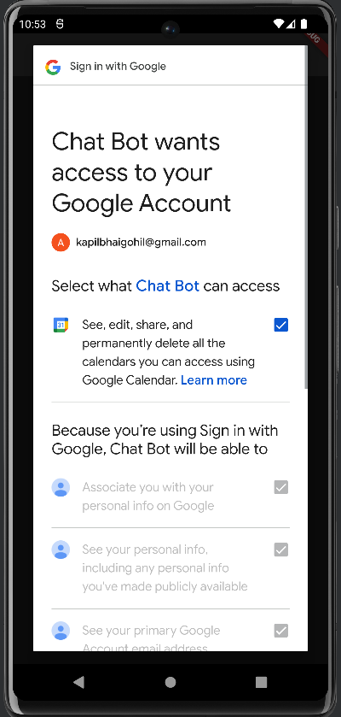

Slide 25
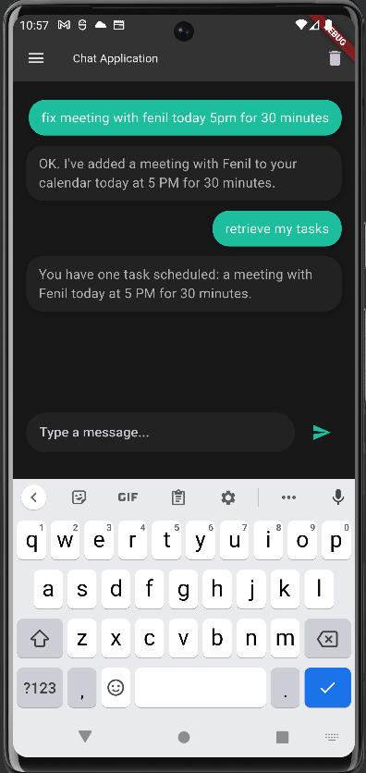
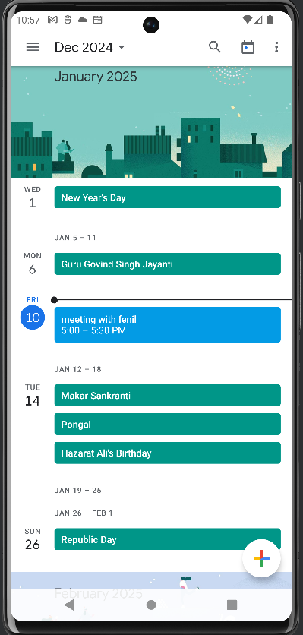
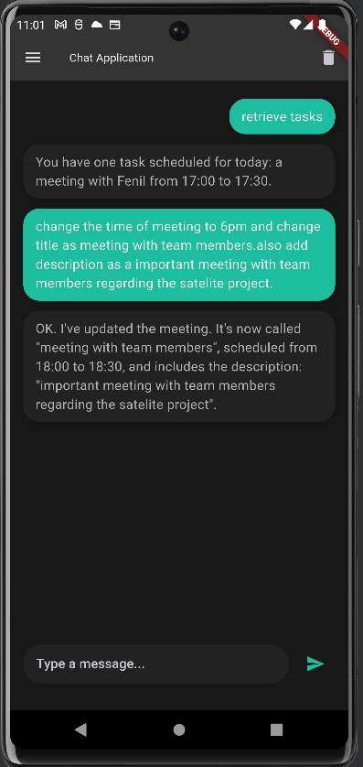

Slide 26
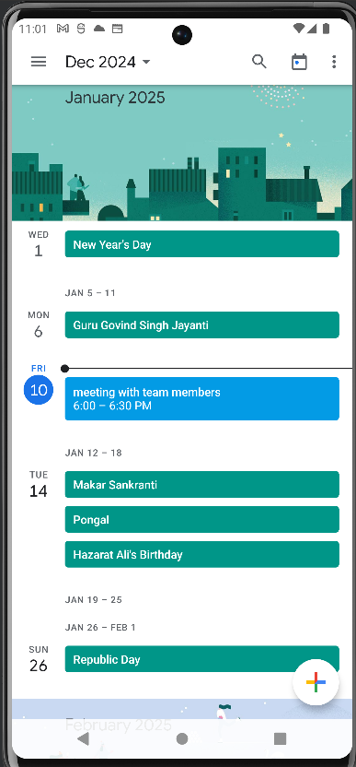
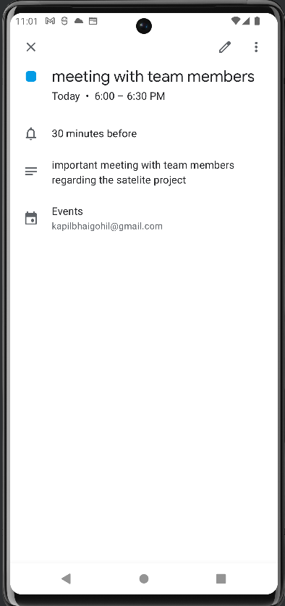
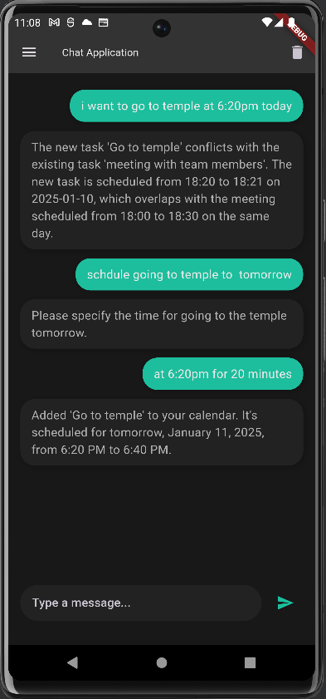

Slide 27
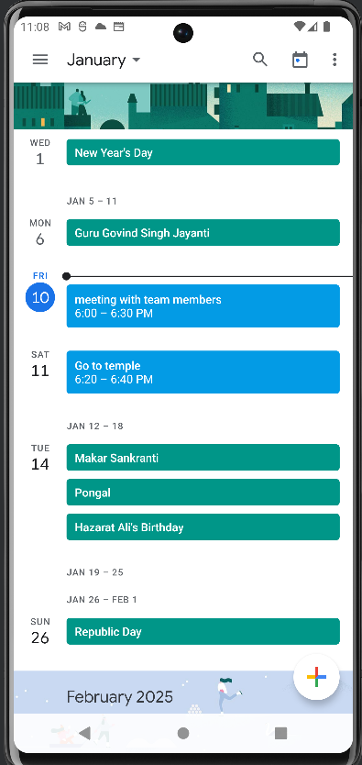
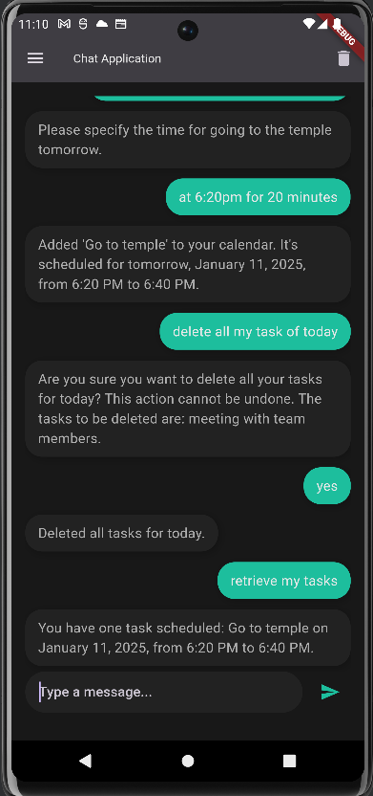
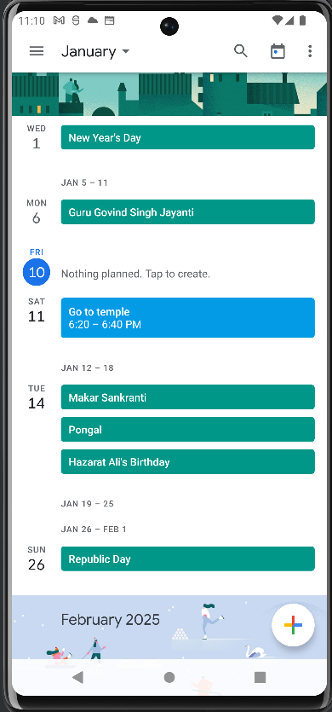

Slide 28
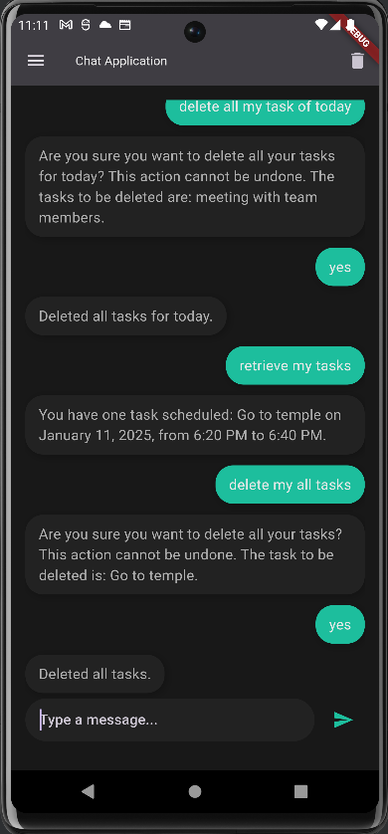
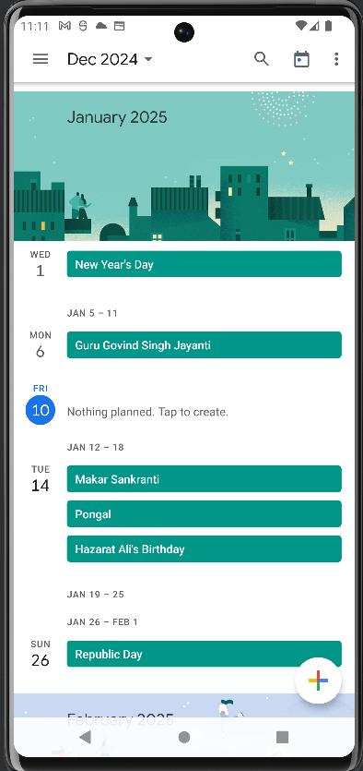

Slide 29
New Features
1. Notification To task
User notified about the task when it is scheduled.
2. Snooze notification option
User can select to remind later which will notify user after some time.

Slide 30
Progress Comparison
Previous Progress:
Backend functionality and CRUD operations completed.
Basic chat UI implemented.
Added secure Google Authentication.
Integrated Google Calendar for task scheduling.
Implemented conflict-checking functionality.
Recent Developments:
Added notification and remind me later option which will notify user about the task at scheduled time.

Slide 31
Project Demo

